Slide 1


Indian Energy Exchange
Price Forecasting

Slide 2
Contents
Power Market - Structure
Power Exchanges
Indian Energy Exchange
Trading Process: Bidding and Matching
Volatility in Market Price
Price Forecasting:
Data Preparation
EDA
Feature Engineering
Feature Extraction
Testing Results
Forecasting Results

Slide 3
Power Market - Structure
Policy Making
Central Government
State Government
Regulations
CERC
SERC
Generations
Central and State Generating Stations
IPPs
Transmission
Central Transmission Utility
State Transmission Utility
IPTC
Distribution
State Distribution Companies
Private Distribution Companies
Markets
Power Exchanges
Bilateral Markets

Slide 4

Power Exchanges

Slide 5
Indian Energy Exchange
India’s energy marketplace, providing a nationwide automated trading platform for the physical delivery of electricity, renewables, and certificates.
6,800+ participants located across 29 States and 5 Union Territories comprising of 55+ distribution utilities and 500+ conventional generators.
Day Ahead Market
Electricity Market
Term Ahead Market
Real Time Market
Cross Border Electricity
Trade
Choices of Market in IEX
Green Term Ahead Market
Green Market
Green Day Ahead Market
Renewable Energy
Certificates
Certificate Market
Energy Saving
Certificates

Slide 6
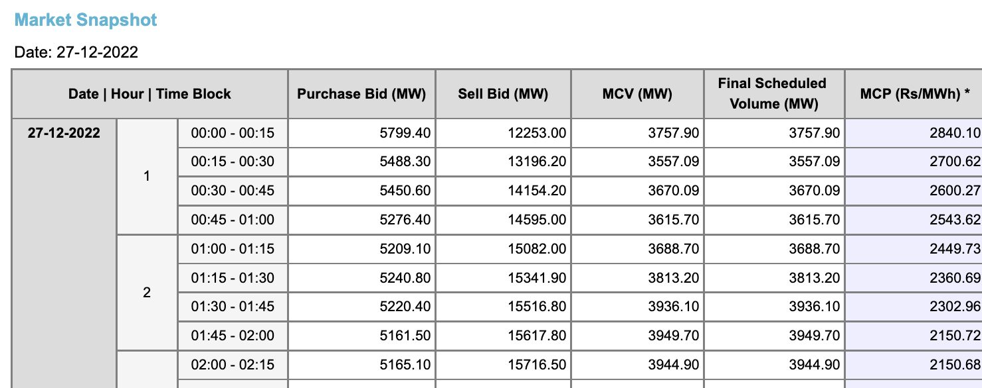
IEX Platform Data

Slide 7
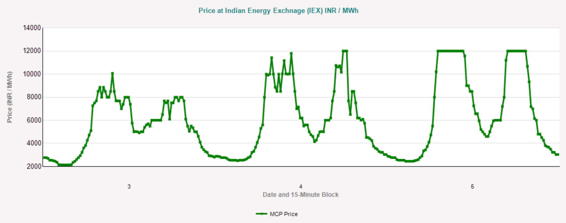
IEX Day-ahead Price plot

Slide 8
Trading Process
Bidding
Day-ahead Market | Real-time Market
Participants enter bids for sale or purchase of power for delivery on the following day. (T+1 day) Bids for a total of 96 blocks of 15 minute each can be entered. Bidding session: 1000 hrs. - 1200 hrs. | 48 bid sessions during the day Each bid session for a duration of 15 minutes First bid session to start at 2245 hrs 15-minute gap between two consecutive bid sessions

Slide 9
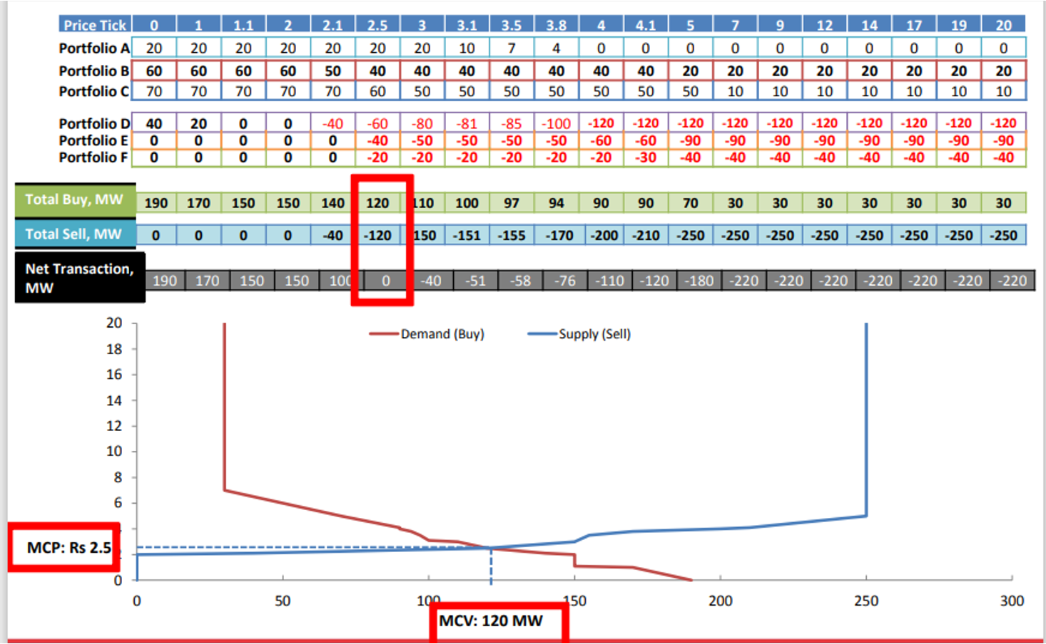
Trading Process
Matching

Slide 10
Volatility in Market Price
Drivers of demand and supply include weather variations over large geographic areas, wind, hydro, solar power stations etc.
Power Distribution Companies (DISCOMs), who offer to supply the power on the exchange procure most of their power through long/medium/short term bilateral contracts with the generators. Further, contracts may end (especially short term – daily, monthly and up to three monthly) at dates which do not have a pattern. In order to serve power, DISCOMs may purchase in day-ahead market.
Some of the generators may lose their generation due to maintenance work.
Sudden rainfall in any region may cause decrease in prices.

Slide 11
Our Objectives:
To analyze and identify the important trends, events and parameters to look for and to forecast price of electricity in different market for IEX that includes:
Day Ahead Market(DAM) price forecast
Real Time Market(RTM) directional forecast
Week Ahead Forecast

Slide 12
Data Preparation and Preprocessing:
IEX Market Clearing Price data:
Data on electricity price (Rs per MwH) have been collected from IEX.
Parameters taken:
Market Clearing Price(MCP)
Market Cleared Volume(MCP)
Purchase Bid
Sell Bid
Weather Data:
For analysis, historical weather data is collected through ERA5.
For forecasting, Meteoblue source is used.
Parameters taken:
Temperature
Apparent/Felt temperature
Relative Humidity
Precipitation Rate

Slide 13
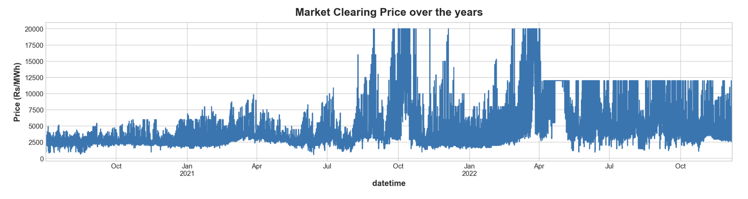
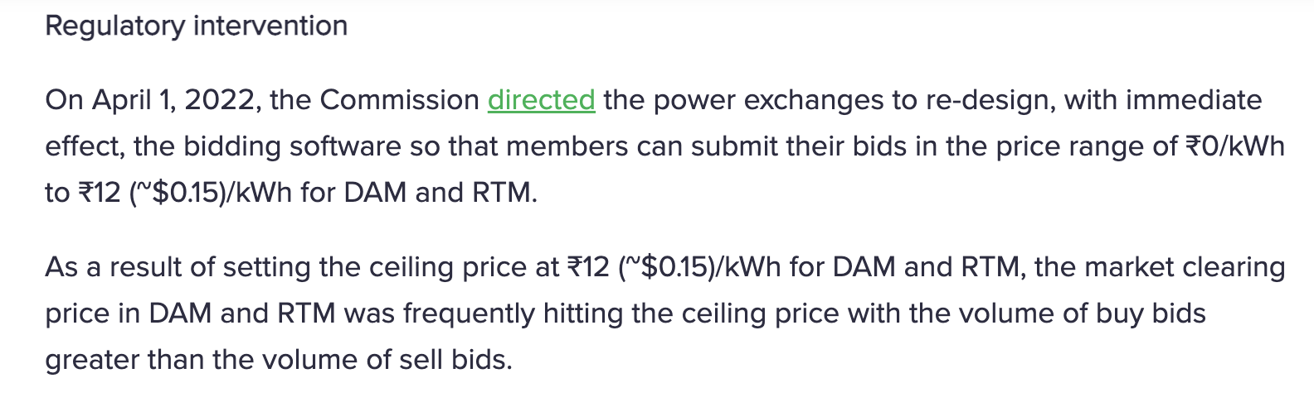
Exploratory Data Analysis:

Slide 14
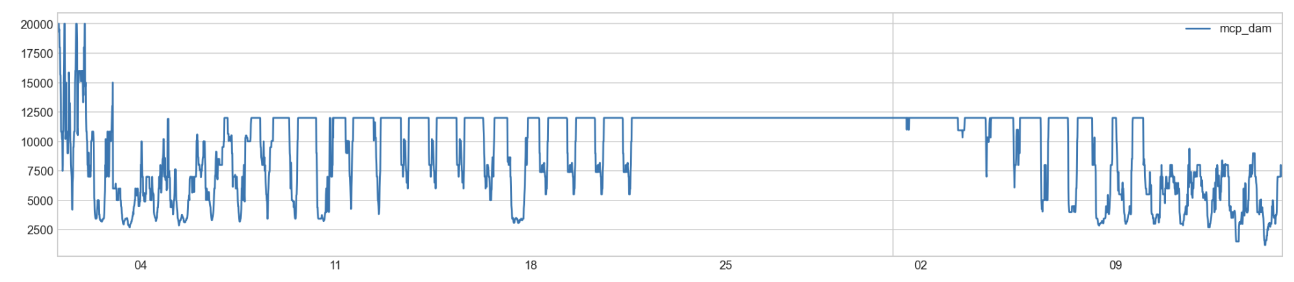
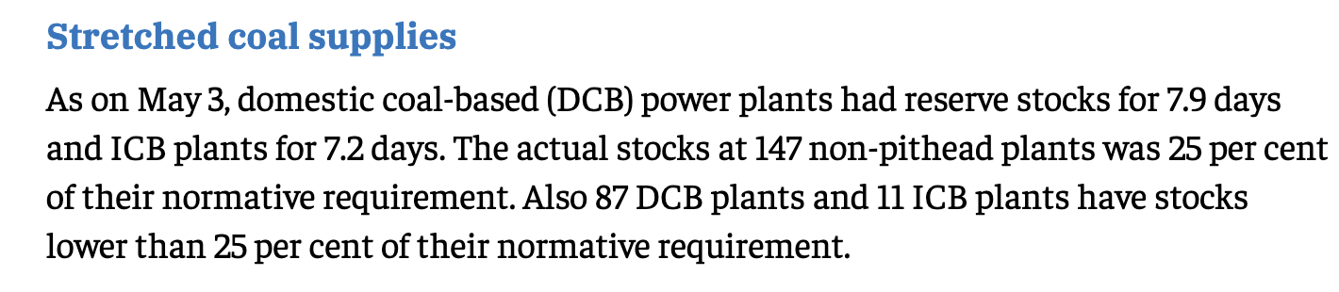

Slide 15
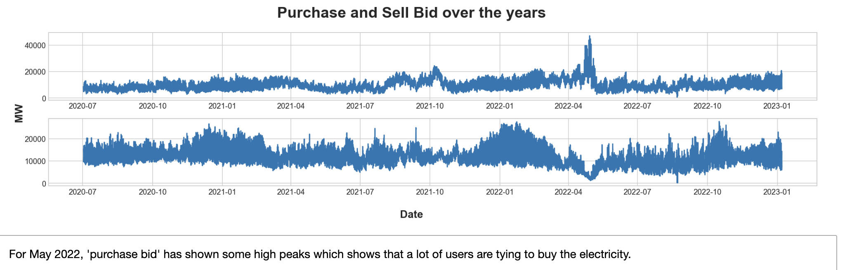

Slide 16
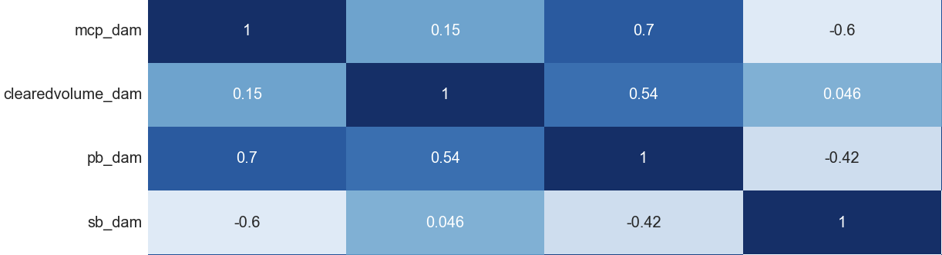
Exploratory Data Analysis(cont.):
Correlations

Slide 17
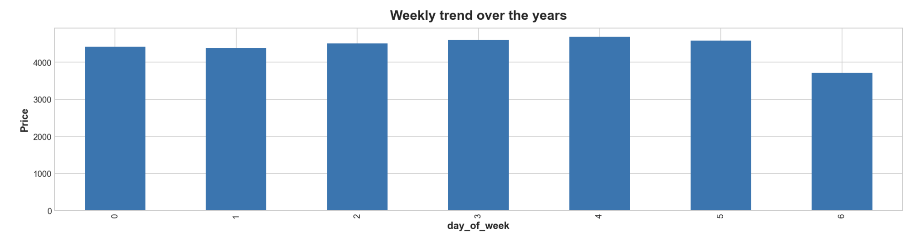
Exploratory Data Analysis(cont.):
Weekly Trend

Slide 18
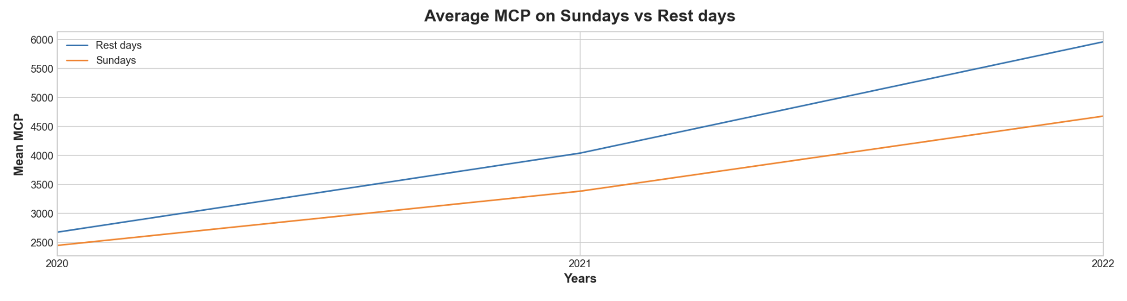
Exploratory Data Analysis(cont.):
Weekly Trend

Slide 19
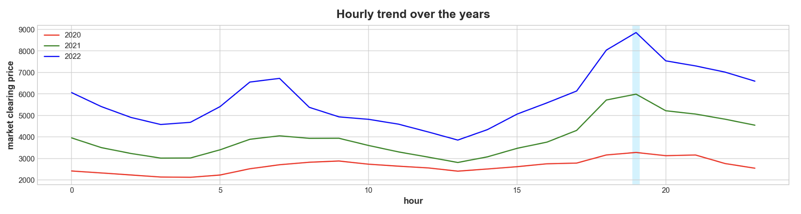
Exploratory Data Analysis(cont.):
Hourly Trend

Slide 20
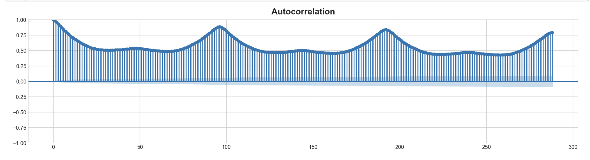
Exploratory Data Analysis(cont.):
Autocorrelation Plot

Slide 21
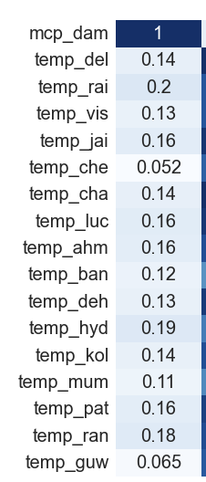
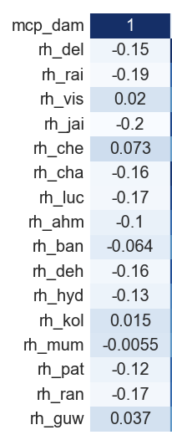
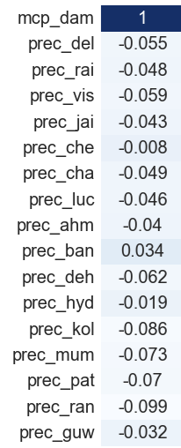
Exploratory Data Analysis(cont.):
Correlation with weather parameters

Slide 22
Feature Engineering:
Lags: Hour lags, Day lags
Exponential Moving Averages
Time Related Features: Date, Hour, Month, Year etc.
Means: Daily mean, Hourly mean
Daily Min, Max
Averages: 2,3,5 day averages for same time block
Precipitation Features:
Daily total precipitation for each city
Total precipitation for all cities for each time block

Slide 23
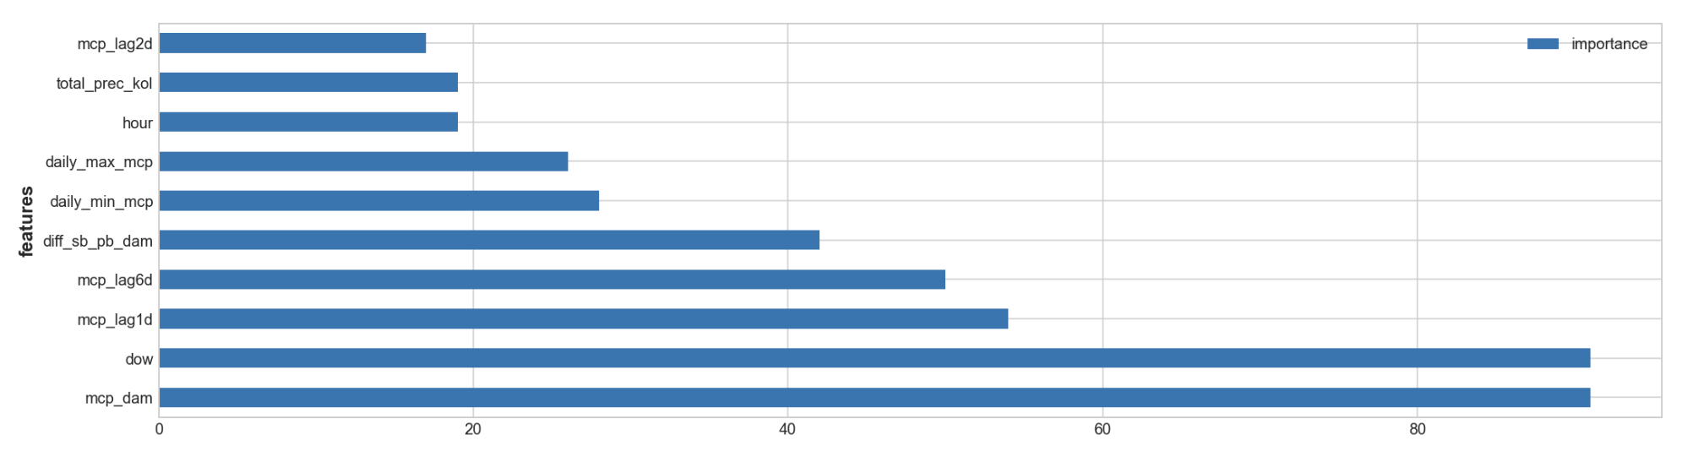
Feature Extraction:
Used Feature Importance for feature selection.

Slide 24
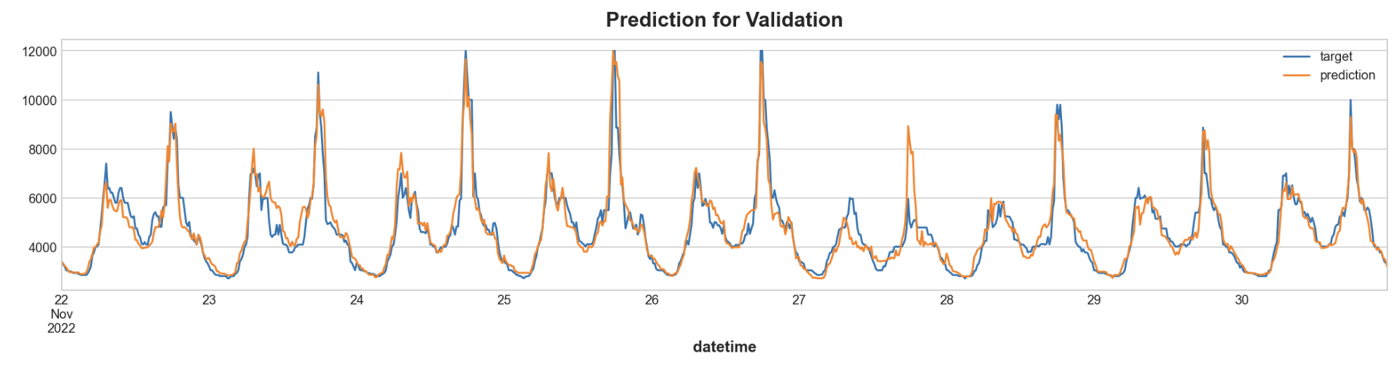
Results on Testing Data:
Used LightGBM model and back test on the month of November.
MAPE achieved: 7.2

Slide 25
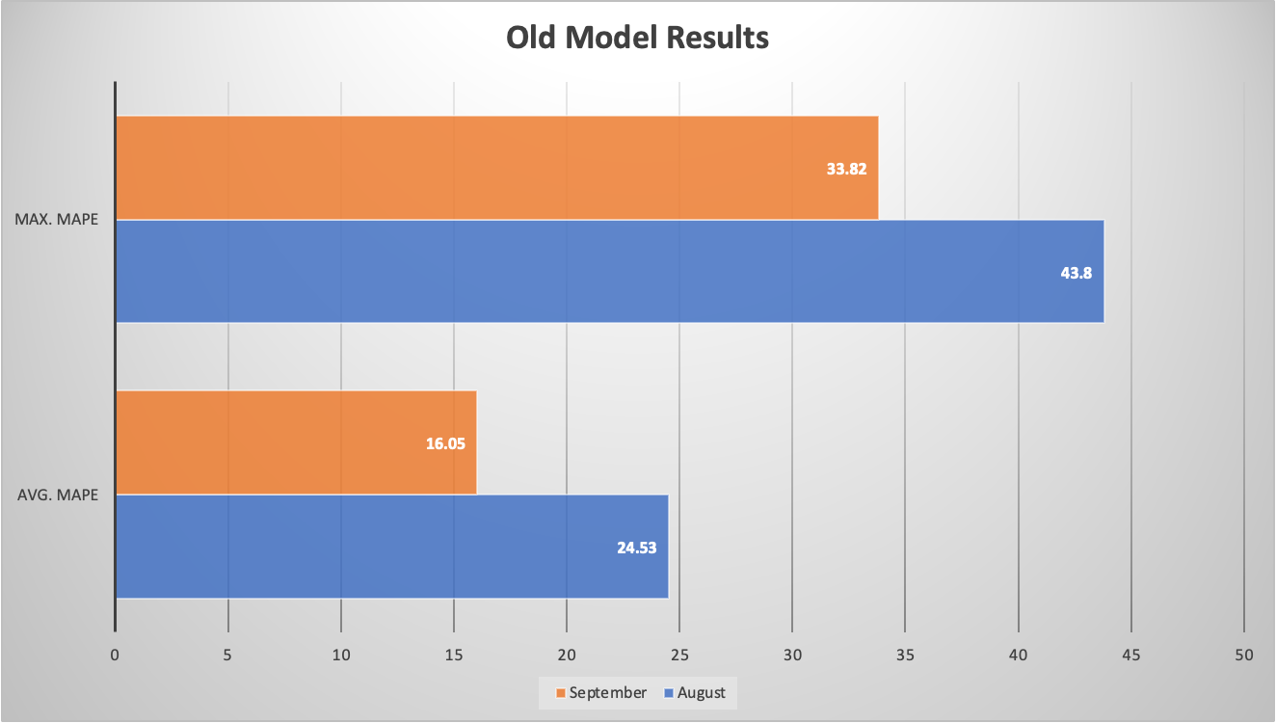
Forecasting Results before creating this model:

Slide 26
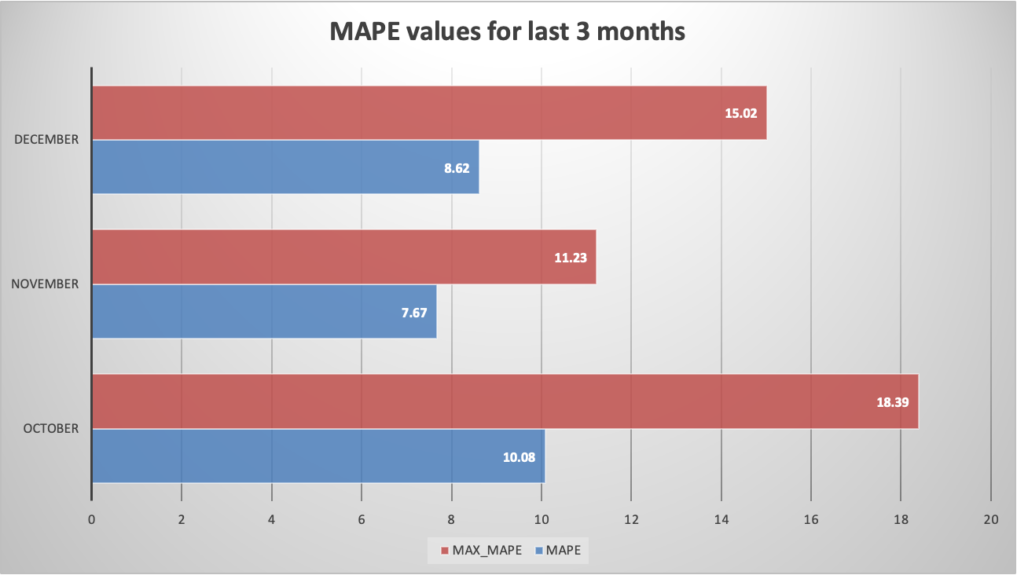
Forecasting Results for Day-ahead:
*Note: For October, the weather data used were from Renew plants and not the cities data.

Slide 27
Directional Forecast:
Same EDA and Feature Engineering has performed with real-time market price and RTM price is forecasted.
Using DAM price forecast and RTM price forecast, Directional forecast is calculated i.e.,
If next day DAM forecast > RTM forecast: 1 is assigned
If next day RTM forecast < DAM forecast: 0 is assigned
If next day RTM forecast = DAM forecast: -1 is assigned

Slide 28
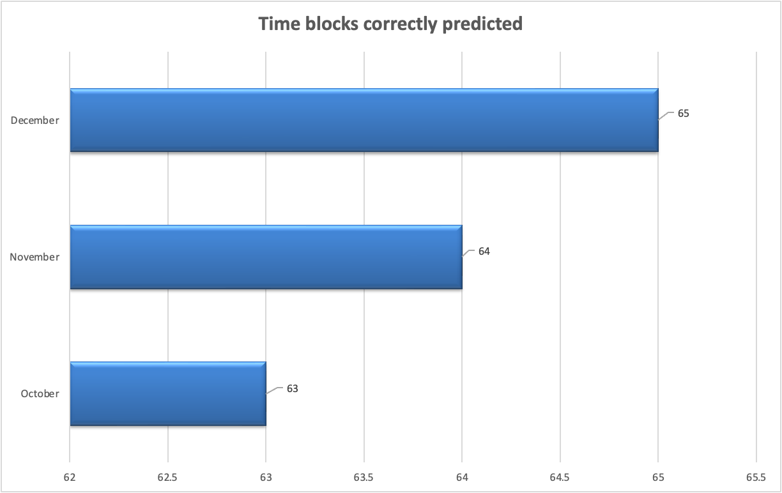
Forecasting Results for Directional:

Slide 29
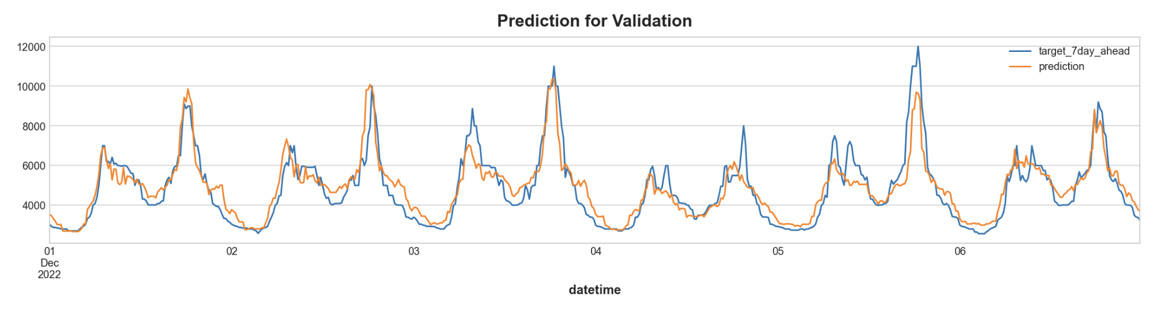
Week-ahead Forecast:
Build 7 different models for each 7-day ahead by shifting the target column.
Average MAPE for week: 9.27

Slide 30
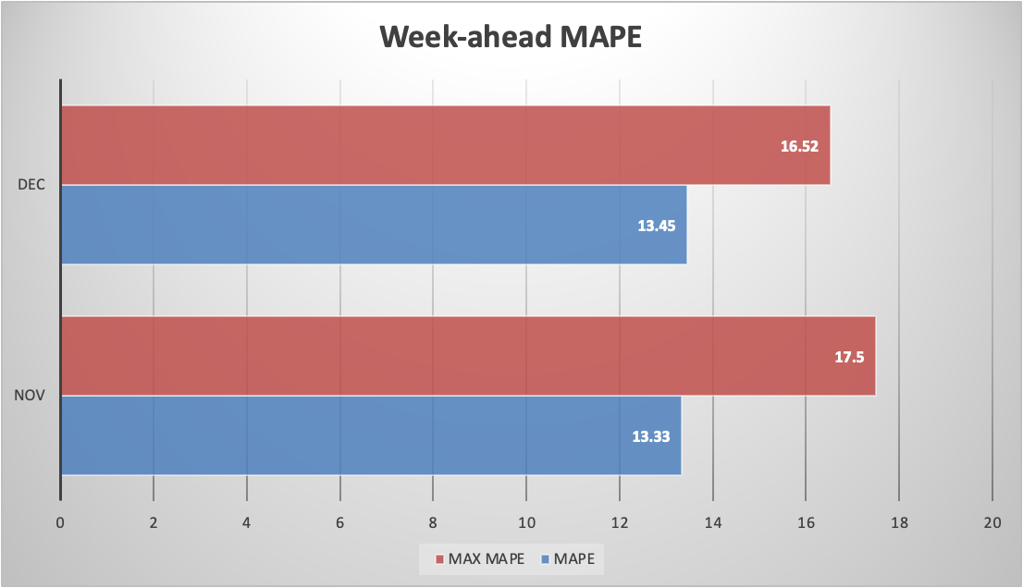
Forecasting Results for week-ahead:

Slide 31
Any
Suggestions !!!
OR
Questions ???

Slide 32
THANK YOU !!!

